Slide 1
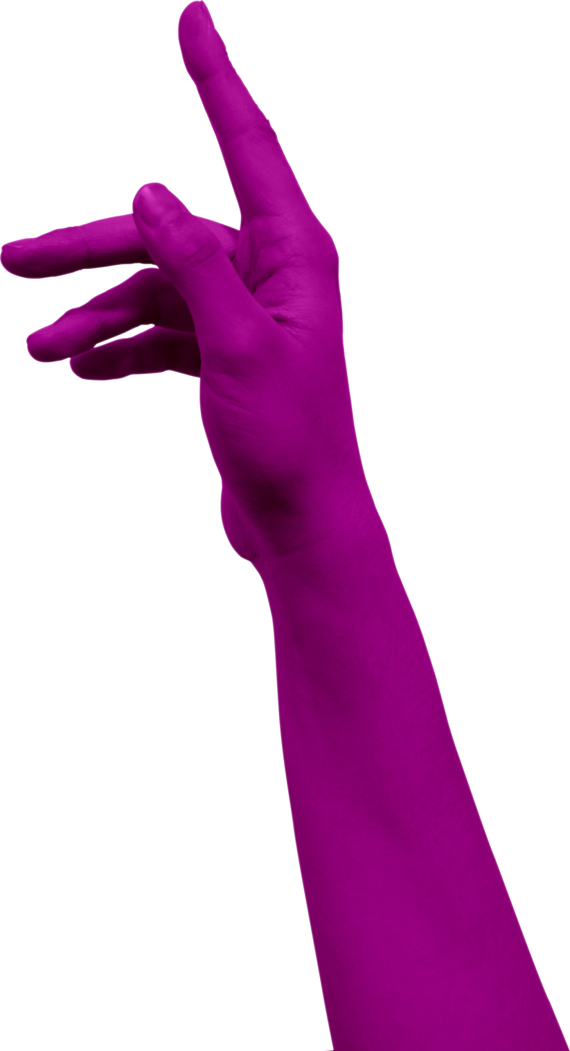
GESTURE AI
HELPING DEAF AND DUMB
A MACHINE LEARNING MODEL

Slide 2
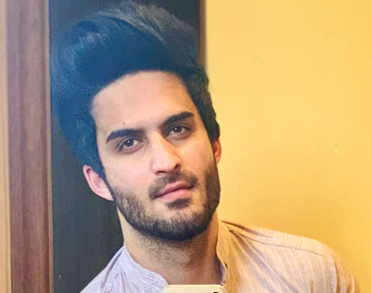
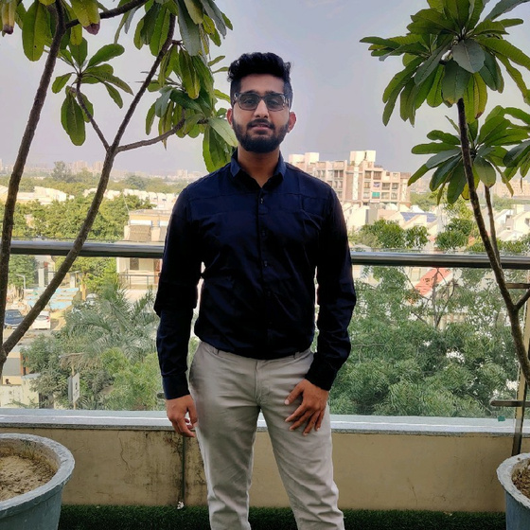
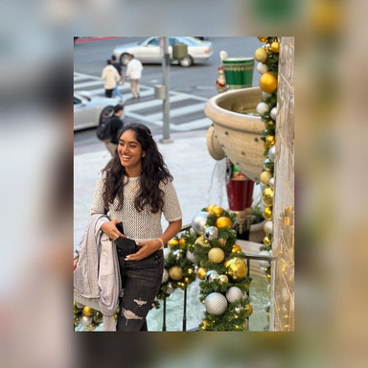
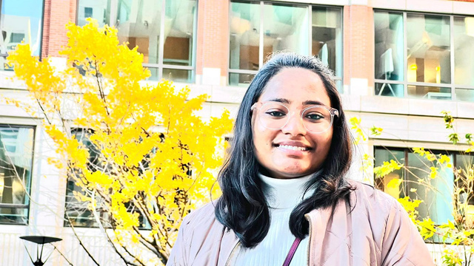
Team Members:
MOHAMMAD ZARAK
KUNJ SHAH
GAAYATHRI CHALASANI
SAI PRASANTHI

Slide 3
Introduction

Slide 4
Sign Language Recognition Using Python
There have been several advancements in technology and a lot of research has been done to help the people who are deaf and dumb. Aiding the cause, Deep learning, and computer vision can be used to make an impact on this cause.
This can be very helpful for the deaf and dumb people in communicating with others as knowing sign language is not something that is common to all, moreover, this can be extended to creating automatic editors, where the person can easily write by just their hand gestures.
WWW.NORTHBOUND.CO

Slide 5
Implementation Plan
Phase I
• Generating Dataset
• Pre-processing Data
• Cleaning Data
• Data Analysis
Phase II
•Choosing Model
• Creating Model
• Training the model
• Validating the model
• Testing model on the dataset
• Checking accuracy of the model
Phase III ‘
• Creating a local machine web application
• Intergrating the model and the web application
• Creating a basic front end
• Testing the web application
d a little bit of body text
Phase III
• Creating a local machine web application
• Intergrating the model and the web application
• Creating a basic front end
• Testing the web application
a little bit of body text

Slide 6
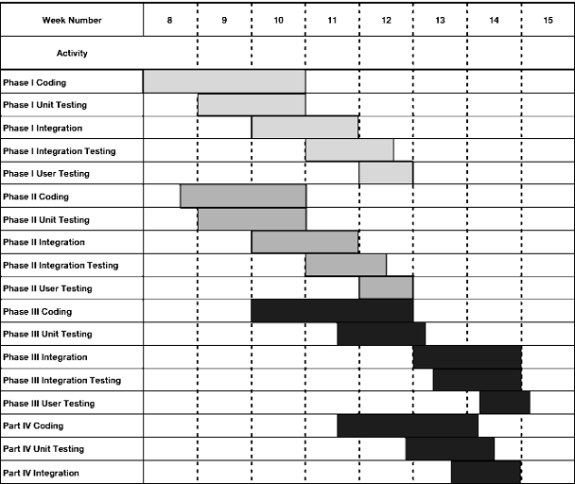
Implementation Breakdown

Slide 7
Implementation Overview
The implementation of the application and model will be approached in a “Top-Down” fashion, where the Phase I would be accomplished first and then moving down further accordingly as shown in the implementation plan. Individual stubs will have to be written to test some methods and the correct performance of the main classes and how they are interacting with the overall end-product. Our implementation will be broken up into 3 phases.
The first phase will consist of the mainly generating the dataset and then preprocessing it, creating a proper dataset will be the driving force behind the software.
Phase two will consist of the creation of the novel Machine learning model that will be trained and tested on the dataset that is being created in the phase I. This model will help us in predicting the gestures that a user is doing via the device camera and the predicted alphabets would be shown above on the device screen.
Phase three will contain the remaining portions of the use cases. Unit testing will be performed along the way a simple web user-interface would be created that would help us to use this model via a local web page coded in Flask.
All coding will be done through Jupyter Notebook and Vs code on the Windows platform and the coding will be done in Python and Flask framework. Testing will be done on a Windows Laptop to get real time results and to aid in visual and program debugging.

Slide 8
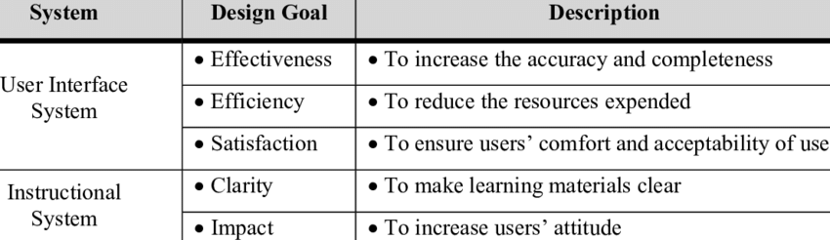
Design Goals

Slide 9



Objective:
Least hardware
Large scability
Variety of situation

Slide 10
Design changes overtime
The first design was to take keypoints (bone structure) of face, arm and hands but with time we understood that to keep the dataset usable with achievable storage we removed the keypoints of face as it was generating really large files with the keypoints of the face.
For the sake of getting greater accuracy the keypoints of arm were also removed so that the hand gesture could be predicted more accurately by the model.
First we wanted to deploy the project online but as to deploy such a web-application the domain space needed to be purchased, therefore the project was run on localhost only.

Slide 11
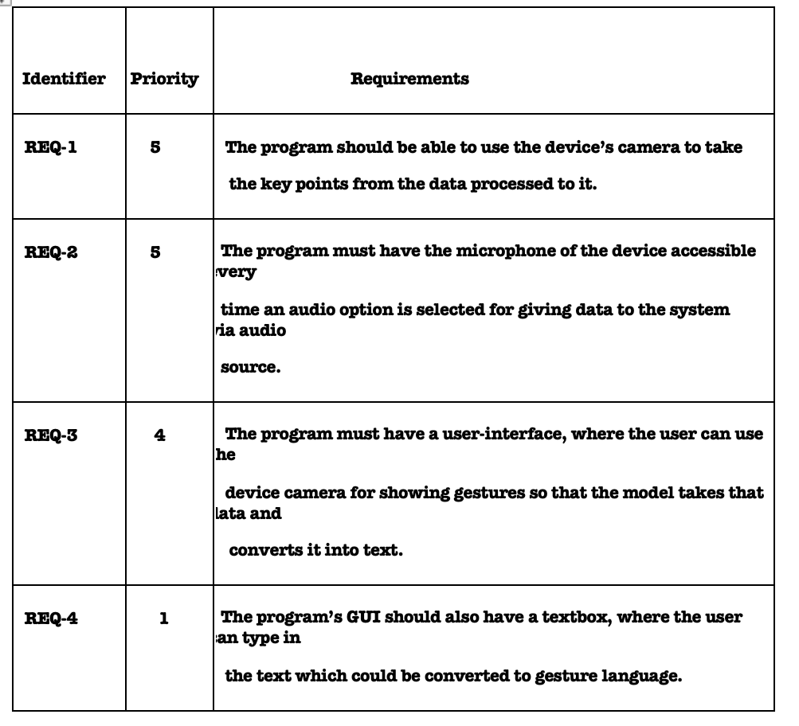
System requirements

Slide 12
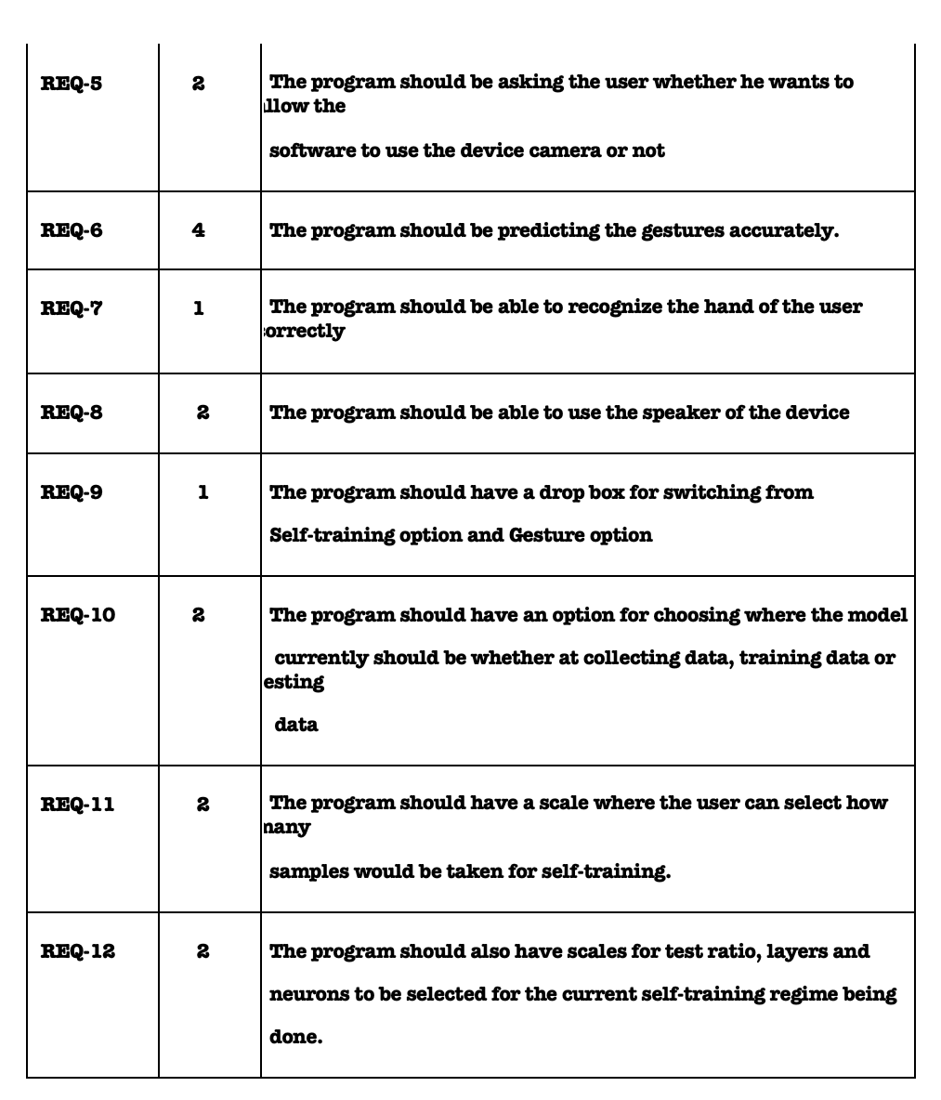

Slide 13
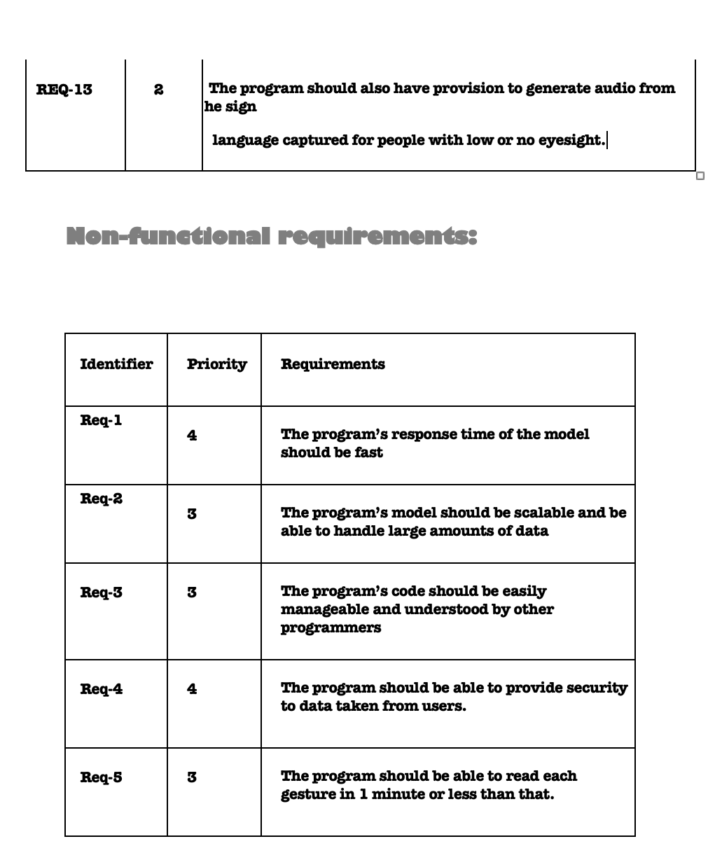

Slide 14
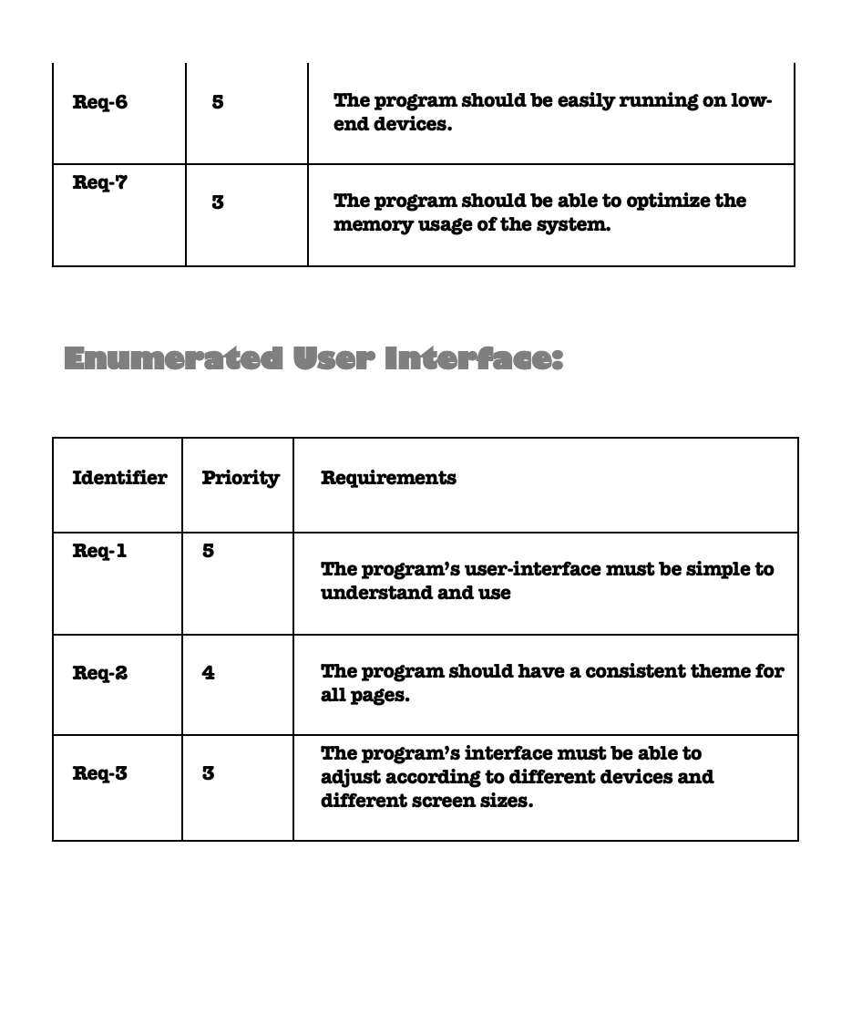

Slide 15
Class list:
Camera: edit, crop, capture, attribute, store_data, compress, decompress
Dataset: collect data, store data, retrieve data
Model: reading data, train, test
Output: translate, display

Slide 16
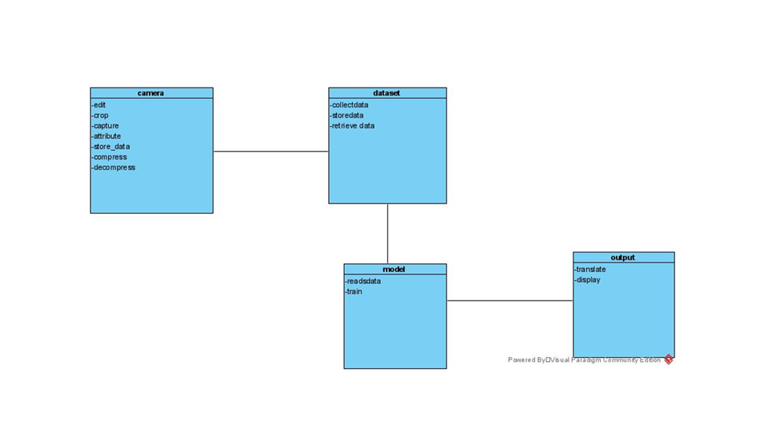
Class diagram:

Slide 17
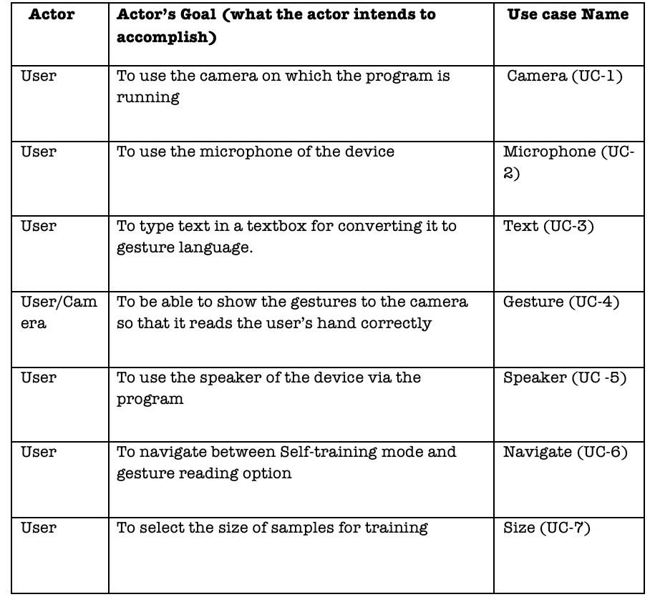
Use cases:

Slide 18
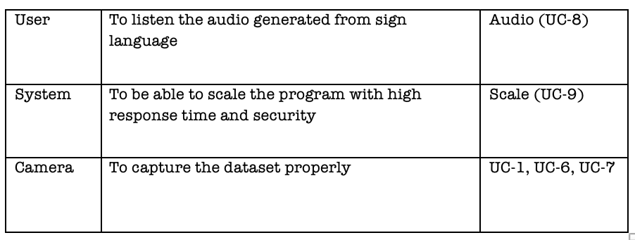

Slide 19
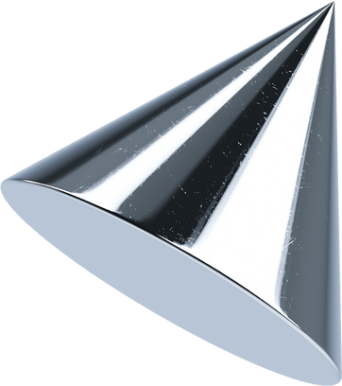
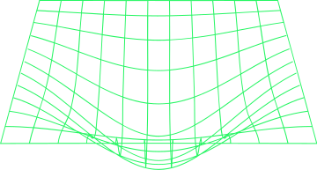
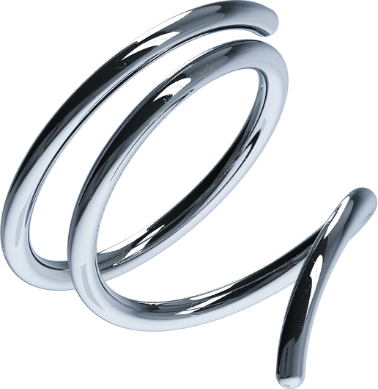
USE CASE DIAGRAMS

Slide 20
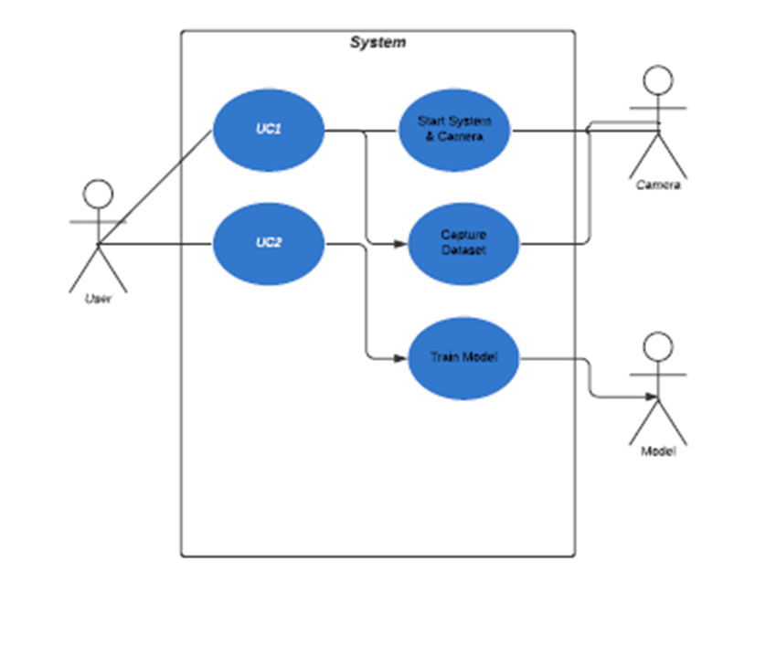
Data Modelling System

Slide 21
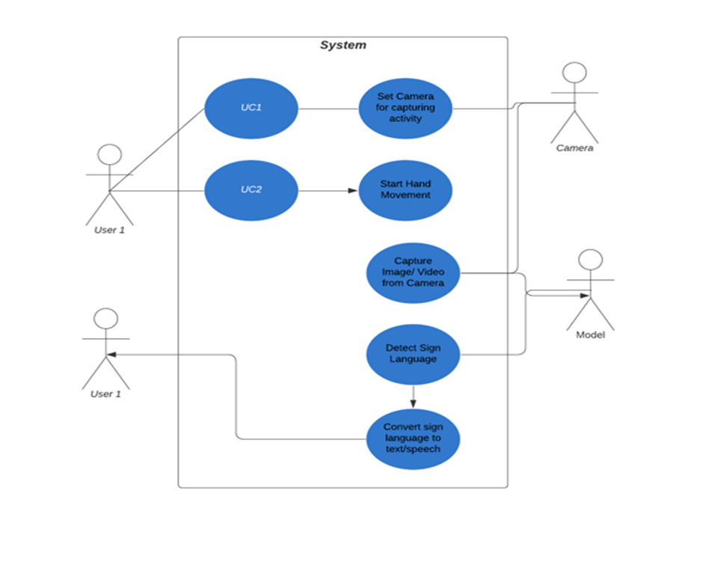
Gesture Subsystem

Slide 22
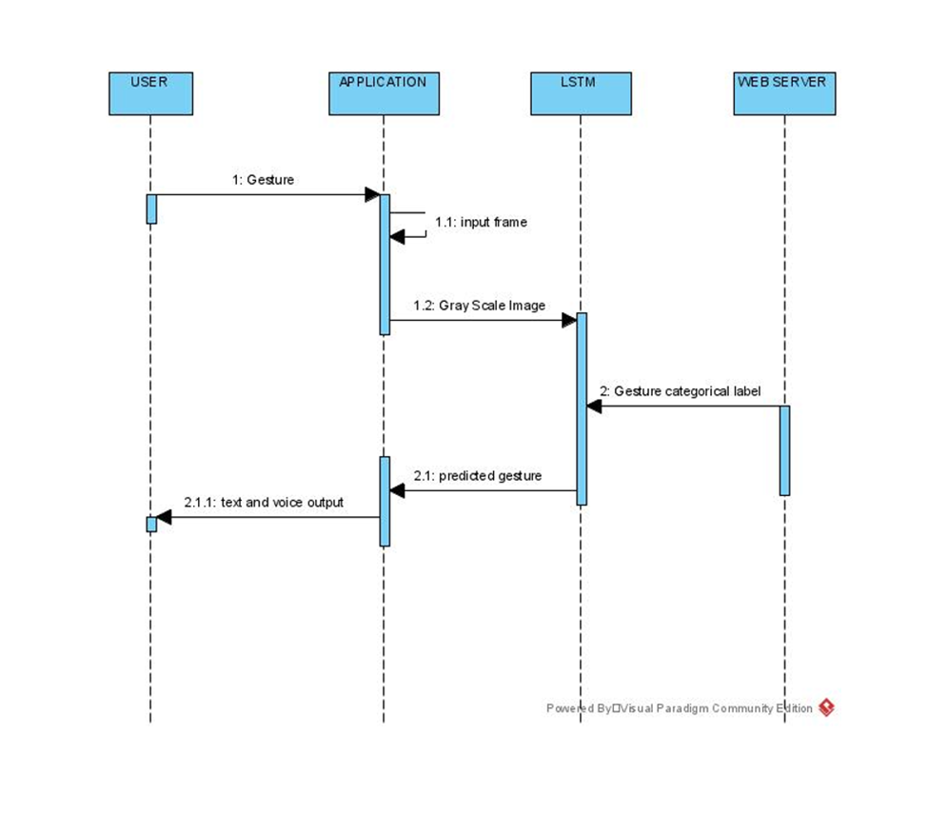
Sequence diagram

Slide 23
State diagram
valid key
image
preprocessing
model
Invalid key
Text/Voice Conversion
It shows prompt again

Slide 24
USER INTERFACE:
1.We would start by using the users device camera to record the sign using hand gestures which would ultimately be the sign language.
2. We are creating a machine learning model that will read in the hand gestures and will try to match it with dataset of all the gestures we have trained the model with.
3. After the matching process the machine learning model predicts the gestures which the current user has used and with help of deep learning neural networks hidden layers it would detect the sign language and convert it into simple text which could be displayed on the screen for the user.
4. This will eventually help people who don't know sign language to understand what a deaf and a dumb person wants to communicate and on the other side it would also help the deaf and dumb person to communicate with people easily.

Slide 25
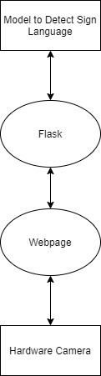
Integration
Machine learning model built in python is being used for detection of sign language
Flask Python is used for API's
HTML , CSS , Bootstrap is used for web user interface which would be helpful in:
Selecting between Hand Gesture to Speech
Selecting between Hand Gesture to Text
We would using device camera to capture video using web and pass it to flask to detect sign language

Slide 26
Demo of Application

Slide 27
Closer look at the concepts being used:
Machine Learning is very useful for a variety of real-life problems. It is commonly used for tasks such as classification, recognition, detection and predictions. Moreover, it is very efficient to automate processes that use data. The basic idea is to use data to produce a model capable of returning an output. This output may give a right answer with a new input or produce predictions towards the known data.
Deep Learning is part of a broader family of machine learning methods. It is based on the use of layers that process the input data, extracting features from them and producing a mathematical model

Slide 28
TECH STACK
Python.
FLASK
Scikit learn.
Pandas.
Tensor-Flow.
CV2.
Html -CSS.
Mediapipe

Slide 29
Pros and Cons of technology used
Python Pros:
Extensive Libraries
Simple and Easy
Readable
Python Cons:
Speed Limitations
Weak in Mobile Computing and Browsers
Design Restrictions

Slide 30
Mediapipe pros
Fast
Modular and Reusable
Doesn’t Care about your Deployment Platform
Mediapipe Cons:
Confusing

Slide 31
Changes with more knowledge
We would have rather taken less frames per a gesture if we knew more about the model creation in depth at start, which we eventually did as it made our model more accurate and reliable
We would really wanted to take the face keypoints but if the storing them was more easy and efficient.
Learning more about ASL sign language would have been a helping hand in creating the dataset.

Slide 32
Summary:
Techniccal challenges:
Problem of Computer vision (cv2) library with Mac OS
Large file creation with more frames per gesture
Higher accuracy of model with more training
Non-technical challenges:
Less time for collaborative work

Slide 33
Overcoming the challenges
We switched to Windows OS for using Computer vision library properly
We tried hit and trail for finalizing the frames per gesture to be used
We changes training data and testing data split to increase accuracy.
We worked individually and kept team meeting short and merged all work on meetings

Slide 34
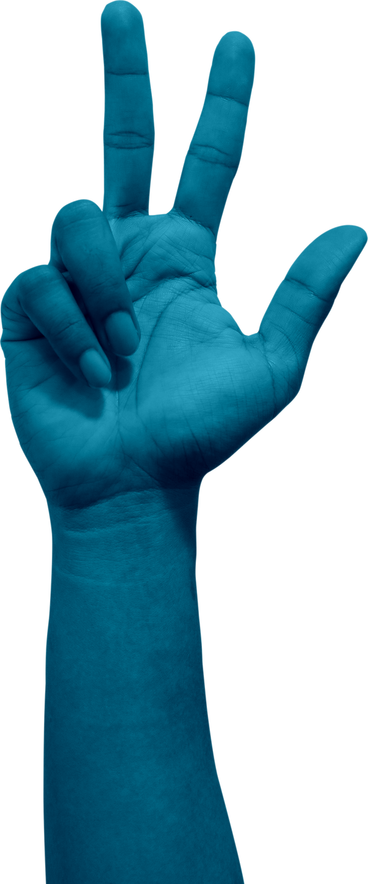
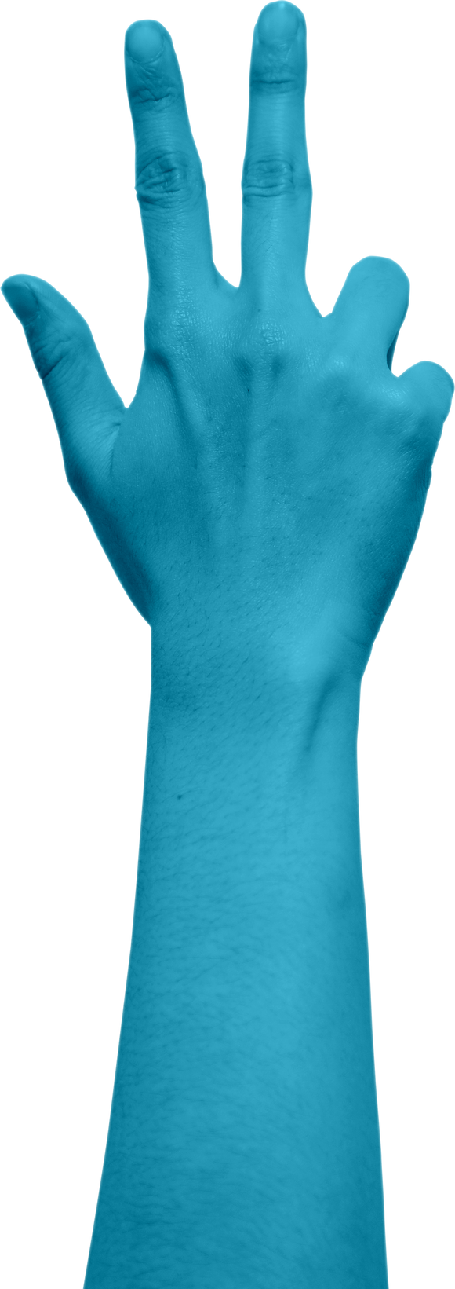
Lessons Learned
Mediapipe can really change the future of how special people interact.
Machine learning would be extensively effecting our lives in near future.
Team work is more important than hardwork.

Slide 35
THANK YOU.

